Slide 1

5. Classification Models and Diagnostics
Jonathan Hersh, PhD (Chapman University Argyros School of Business)

Slide 2
Outline
Classification with Logistic
Diagnostics
Confusion Matrices
ROC Curves
Calibration Plots
Class Imbalance

Slide 3

Classification Basics

Slide 4



Classification examples

Slide 5
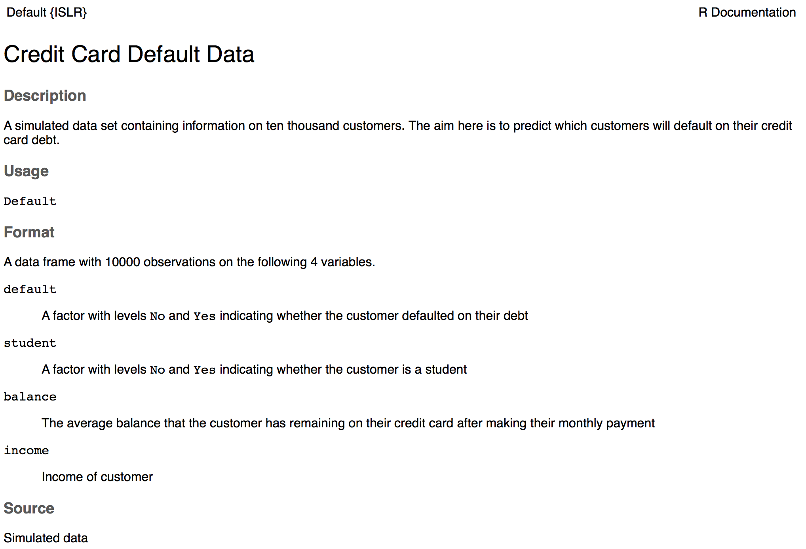
Credit Card Default Dataset

Slide 6
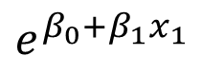
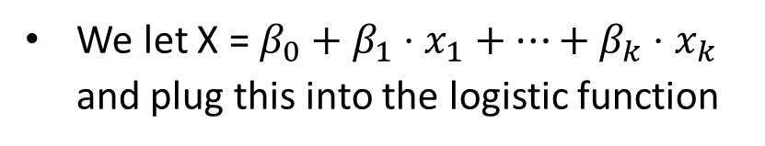
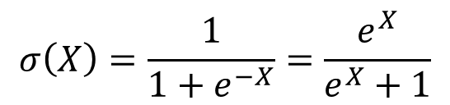
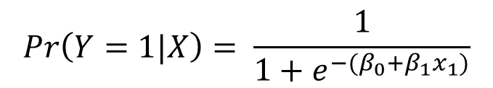
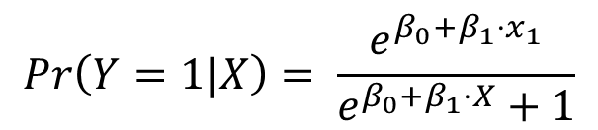
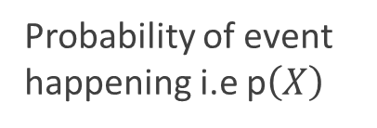
Using the Logistic/Sigmoid Function to Generate Probabilities
How do we generate probabilities from the logistic function?
Probability of event happening i.e p$\left(X\right)$
1
We let X = $β_{0}+β_{1}⋅x_{1}+…+β_{k}⋅x_{k}$ and plug this into the logistic function
$$σ\left(X\right)=\frac{1}{1+e^{−X}}=\frac{e^{X}}{e^{X}+1}$$
0.5
$$Pr\left(Y=1|X\right)= \frac{e^{β_{0}+β_{1}⋅x_{1}}}{e^{β_{0}+β_{1}⋅X}+1}$$
0
0
$$e^{β_{0}+β_{1}x_{1}}$$
100
200
$$Pr\left(Y=1|X\right)= \frac{1}{{1+e}^{{−(β}_{0}+β_{1}x_{1})}}$$
This is equivalent mathematically! I promise. Work it out on pen and paper if you don’t believe me

Slide 7
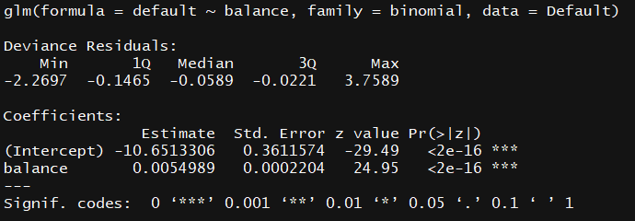
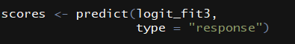
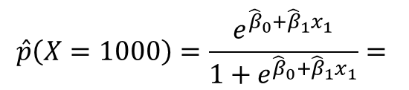
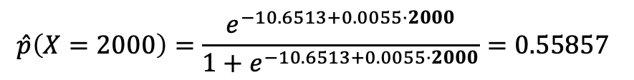
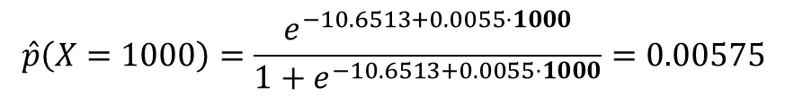
Generating Predicted Probabilities from a Logit Model
To generate predictions, we use the estimated coefficients in the logit equation
$$\hat{p}\left(X=1000\right)=\frac{e^{{\hat{β}}_{0}+{\hat{β}}_{1}x_{1}}}{1+e^{{\hat{β}}_{0}+{\hat{β}}_{1}x_{1}}}=$$
The estimated probability of default with a balance of $1,000 is given by
$$\hat{p}\left(X=1000\right)=\frac{e^{−10.6513+0.0055⋅1000}}{1+e^{−10.6513+0.0055⋅1000}}=0.00575$$
The estimated probability of default with a balance of $2,000 is given by
$$\hat{p}\left(X=2000\right)=\frac{e^{−10.6513+0.0055⋅2000}}{1+e^{−10.6513+0.0055⋅2000}}=0.55857$$
To generate predicted probability for all observations in a dataset we use the predict function, but note type = “response”!
This is also called “scoring” a dataset

Slide 8
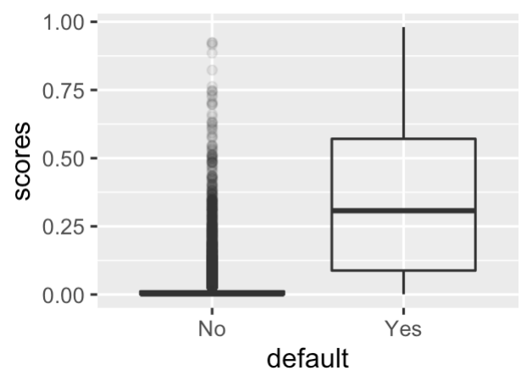
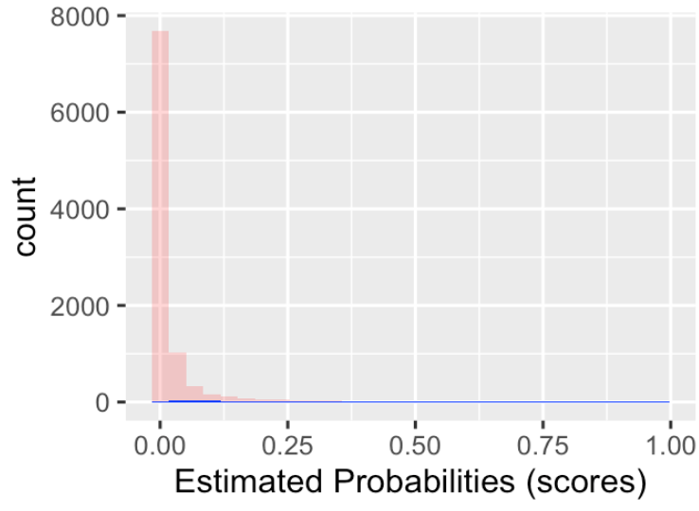
What Do We Do With Scores or Estimated Probabilities?
Okay, so we have probabilities, what then?
Note there is almost always some overlap between the probabilities of the classes
We can’t choose a probability such that above this all actual defaulters are correctly identified, and below this all non-defaulter are identified
So we will always have some false positives and false negatives

Slide 9
Confusion Matrix: Table of False/True Positives and False/True Negatives
 |  | True default status
 |  | No | Yes
Predicted default status | No | True negative (TN) | False Negative (FN)
 | Yes | False Positive (FP) | True Positive (TP)

Slide 10
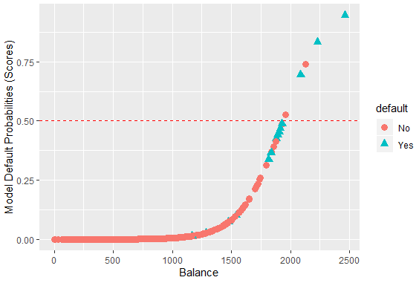
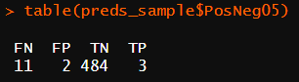
Assigning Class=Default to $\hat{p}>0.5$
Above this line, observations are classified as defaulting
Classify as “default”
Below this line, observations classified as not defaulting
Actual default = teal triangles
Actual not default = circle
Classify as “not default”
If we choose a probability cutoff of 0.5, then we see we have 2 false positives and 11 FN
Note I’m working with a 5% sample of the dataset to make the numbers easier

Slide 11
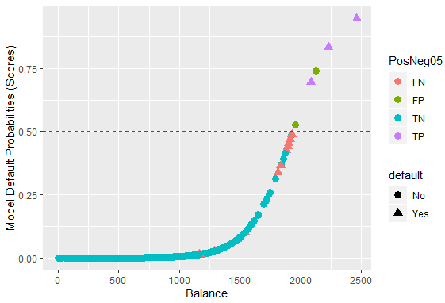
Assigning Class=Default to $\hat{p}>0.5$
If we choose a probability cutoff of 0.5, then we see we have 2 false positives and 11 FN
Classify as “default”
Classify as “not default”

Slide 12
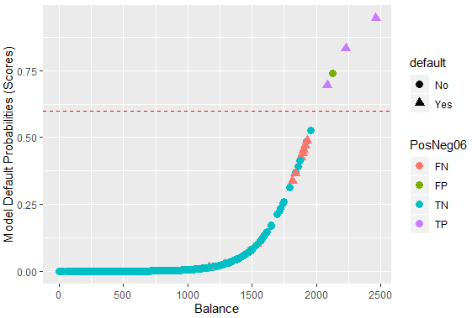
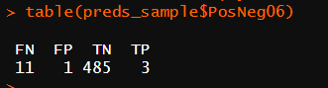
Assigning Class=Default to $\hat{p}>0.6$
Raising the cutoff to 0.6, then we see we have 1 false positives and 11 FN
Classify as “default”
Classify as “not default”

Slide 13
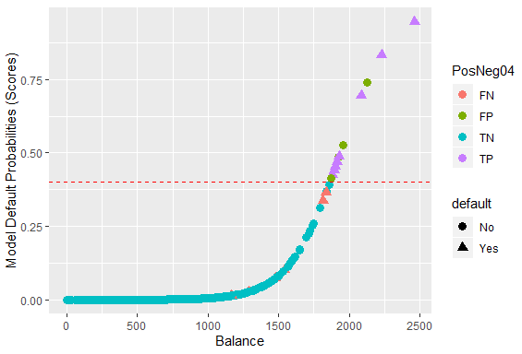
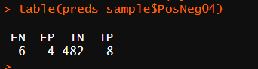
Assigning Class=Default to $\hat{p}>0.4$
Lowering the cutoff to 0.4 results in more FPs (4) but fewer FNs (6)
Classify as “default”
Classify as “not default”

Slide 14
Choosing Probability Cutoff to Assign Class
True
Default = 0
True Default = 1
Model Probabilities

Slide 15
Threshold A: Moderate Threshold
Threshold A
True
Not Default
True Default
False
Negatives
False
Positives
-
+
Model Probabilities

Slide 16
Threshold B: Higher Threshold
Threshold B
True
Not Default
True Default
False
Negatives
Model Probabilities
False
Positives

Slide 17
Comparing cutoffs:
Threshold A
True
Not Default
True Default
Many false positives
-
+
Threshold B
True
Not Default
True Default
Few false positives
Model Probabilities

Slide 18
Which Probability Cutoff To Use?
Threshold A
Threshold you choose should depend on relative costs of FPs and FN
e.g. screening at airport (cost of false neg high)
e.g. direct mail advertisement (cost of false positive low)
Some common choices
Maximize Accuracy (equal weighting of FPs and FNs)
Threshold p_hat > 0.5
Minimize cost: TC = costFP *FPs + costFN * FNs
True
Not Default
True Default
-
+
Threshold B
True
Not Default
True Default
Model Probabilities

Slide 19
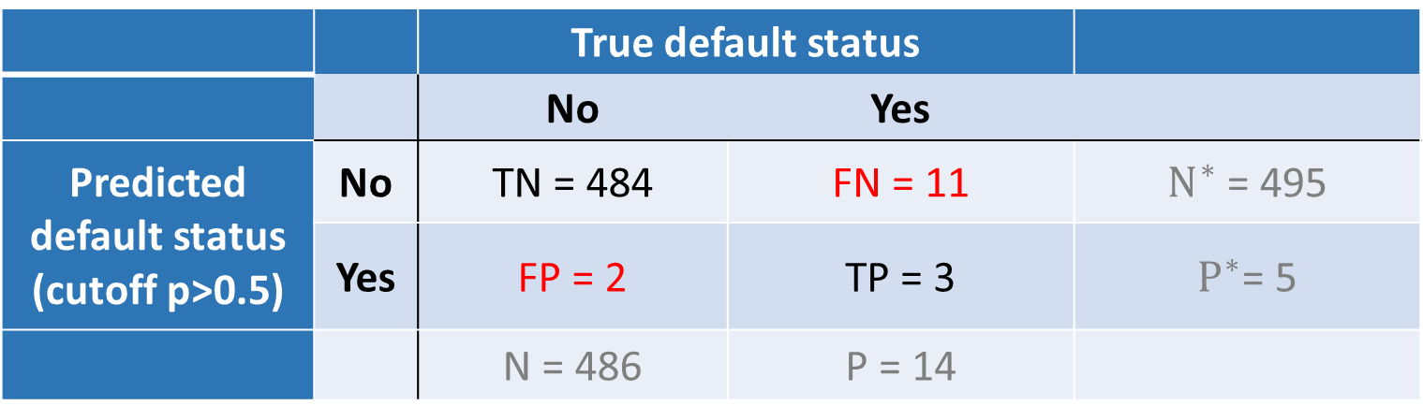
Sensitivity and Specificity, Confusion Matrix at P Cutoff > 0.5
 |  | True default status
 |  | No | Yes
Predicted default status (cutoff p>0.5) | No | TN = 484 | FN = 11 | $N^{∗}$ = 495
 | Yes | FP = 2 | TP = 3 | $P^{∗}$= 5
 |  | N = 486 | P = 14
Sensitivity: True positive rate (aka 1 – power or recall)
TP/P = 3 / 14 = 21.4%
Specificity: True negative rate
TN/N = 484 / 486= 99.5%
False positive rate (aka Type I error, 1 - Specificity)
FP/N = 2/486= 0.004%

Slide 20

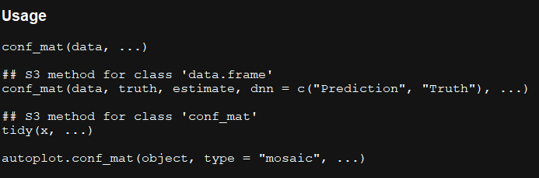
Generating Confusion Matrices in R
To produce a confusion matrix in R we will use the yardstick package
The function conf_mat() produces confusion matrices but we must format our data correctly
We need to specify a data frame with
Actual event (Y = 1) values
Our estimated probabilities (scores)
This example data frame shows how we need to structure our results data frame

Slide 21
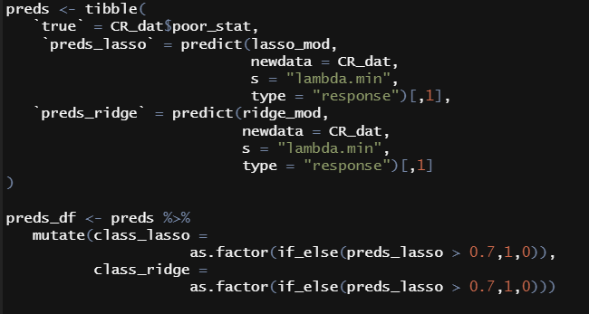
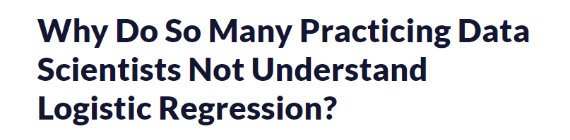
Formatting Results Matrix for Confusion Matrix
Let’s store the model results in a data frame
We must specify the actual poverty status
We *must* specify a cutoff above which probabilities are classified as “class1” (or having the event) and below which they are not
Here I’ve chosen 0.7 but we may need to alter this
The cutoff probability is determined by the relative cost of false positives and false negatives! Do not use rules of thumb!
https://ryxcommar.com/2020/06/27/why-do-so-many-practicing-data-scientists-not-understand-logistic-regression/

Slide 22
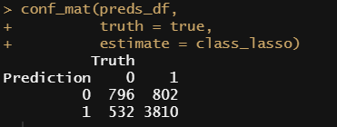
Producing Confusion Matrix Using Formatted Results Data
The conf_mat() function shows the confusion matrix
If we summarize the conf_mat() object we see more binary metrics of classification (don’t need to know all of these)
Sensitivity is the true positive rate (TP/P) and here we identify of the true positives = 131/333 = 39.3%
We may need to lower our threshold of cutoff probability

Slide 23
Continuous Cutoff: ROC Curve
Cutoff p>0.01
100%
Can we show consequences of FPs and FNs as we vary the cutoff probability to assign classes?
Idea of a ROC (Receiver Operator Curve) plot
If model is no better than chance on this line
True positive
rate
Cutoff p>0.4
Cutoff p>0.5
Cutoff | TPR | FPR
0.01 | 100% | 22.6%
0.4 | 57% | 0.008
0.5 | 21.4% | 0.004%
0.6 | 21.4% | 0.002%
False Positive Rate
100%

Slide 24
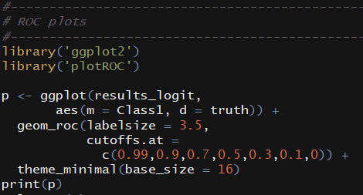
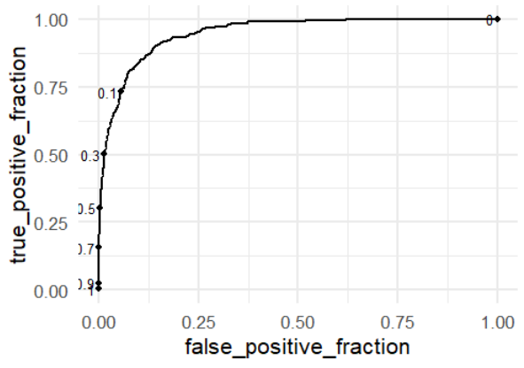
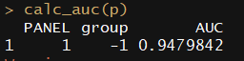
ROC Curves in R
At a cutoff of 0.3, we get a true positive fraction of 0.5 and a false positive fraction of a very low number
Better models lie up and to the left in the ROC plot
AUC calculates how much total area is under a particular curve
AUC of 0.947 is pretty good

Slide 25
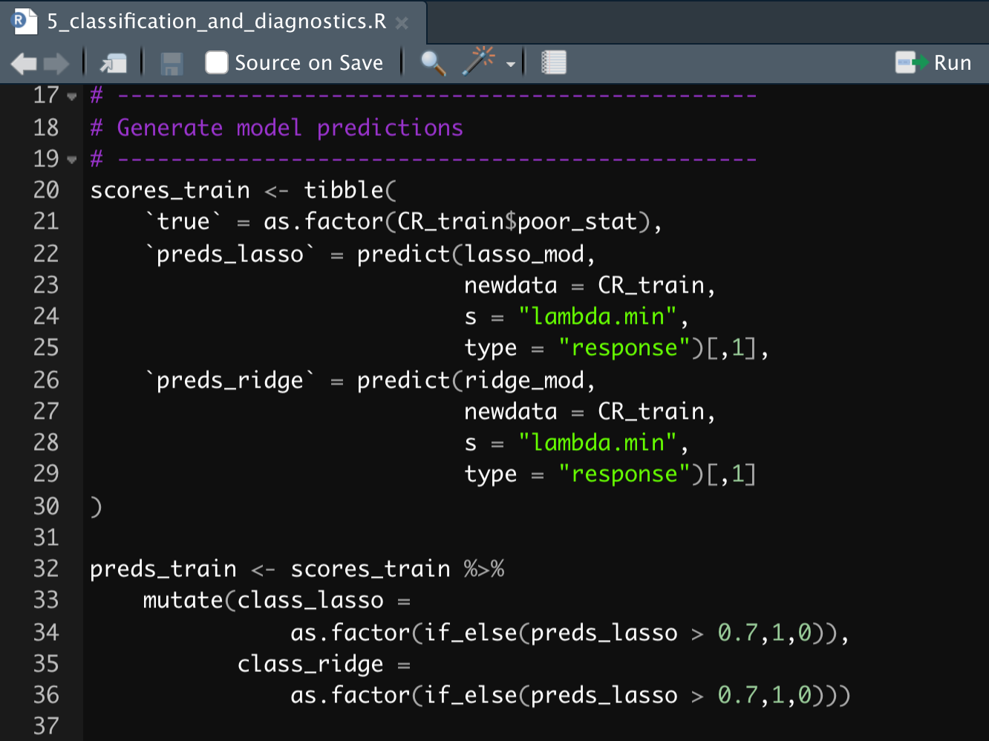
Classification and Diagnostics Lab
Open the file 5_classification_and_diagnostics.R
Generate model predictions using the lasso model applied to the training set
Estimate a confusion matrix and a ROC plot for the training set
Time permitting, do the same for the test set

Slide 26
Outline
Classification with Logistic
Confusion Matrices
ROC Curves
Calibration Plots

Slide 27
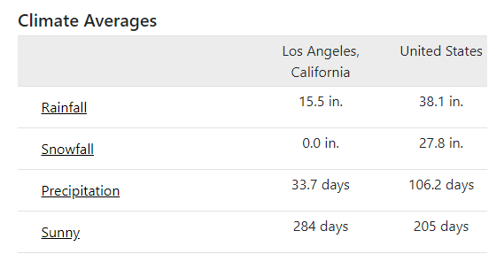
Chuck Klosterman on Probability
This is an incorrect understanding of probability. Obviously something can only happen or not happen
Ex-post (after the fact) we can say odds were 50-50. But ex-ante, odds are clearly not 50-50
There is not a 50% chance it snows tomorrow in LA. How do we know? History tells us.
“Life is chock full of lies, but the biggest lie is math. That’s particularly clear in the discipline of probability, a field od study that's completely and wholly fake. When push comes to shove - when you truly get down to the core essence of existence - there is only one mathematical possibility: Everything is 50-50. Either something will happen or it won’t”
- Chuck Kloserman, being wrong about probability

Slide 28
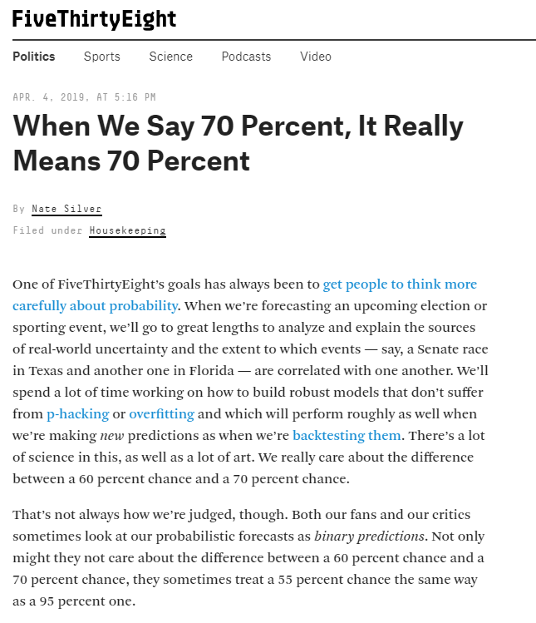
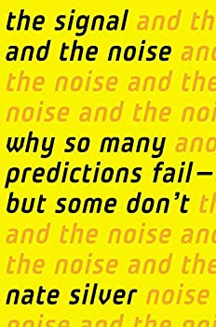
So What Does it Mean to Predict Binary Events Well?
One person you should read if you care about prediction is Nate Silver
Calibration measures whether, over the long run, events occur about as often as you say they’re going to occur. For instance, of all the events that you forecast as having an 80 percent chance of happening, they should indeed occur about 80 out of 100 times; that’s good calibration. If these events happen only 60 out of 100 times, you have problems — your forecasts aren’t well-calibrated and are overconfident. But it’s just as bad if they occur 98 out of 100 times, in which case your forecasts are underconfident.
https://fivethirtyeight.com/features/when-we-say-70-percent-it-really-means-70-percent/

Slide 29
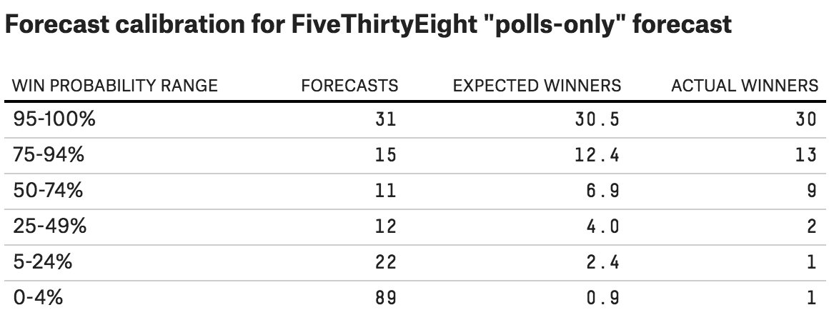
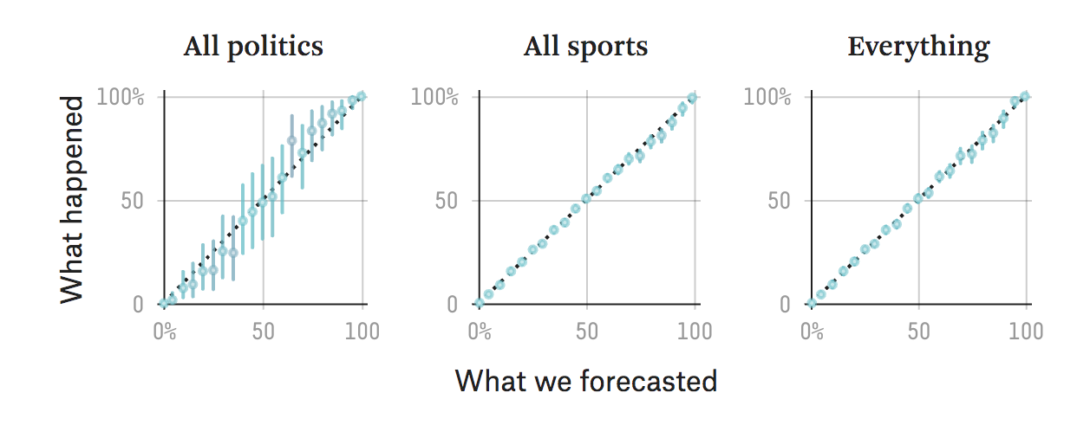
Are Nate Silver’s Forecasts Well Calibrated?
95% probability of win means out of 20 you forecast with 95% probability, 19 should win!
10% probability of win means out of 20 forecasts with 10% probability 2/20 should win!
Overall Nate Silver is well calibrated, but politics is more noisy!
https://fivethirtyeight.com/features/when-we-say-70-percent-it-really-means-70-percent/

Slide 30
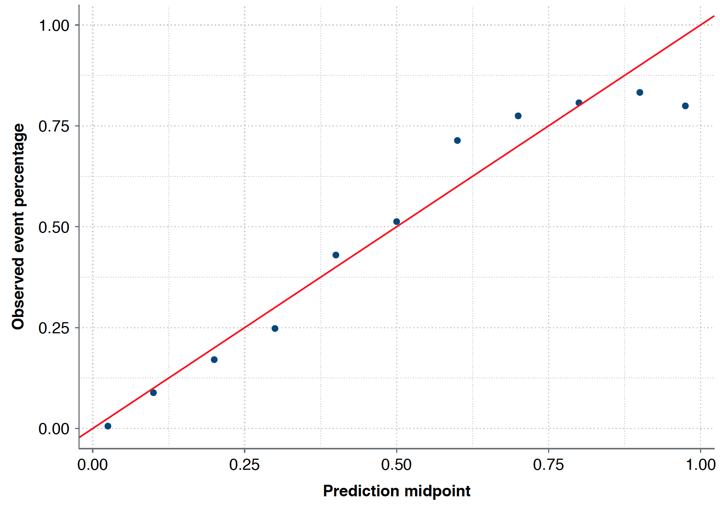
Calibration plot
Idea of a calibration plot:
A well-calibrated prediction is one where if we give an X% probability of an event occurring, X/100 of the time the event happens.
For 1/10 of them the event should actually occur
All obs where we predict
10% chance of event occurring

Slide 31
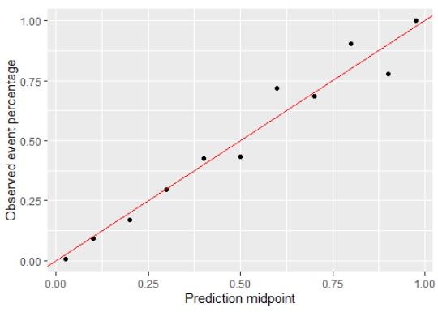
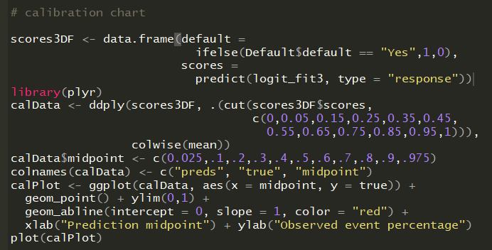
Calibration plot

Slide 32
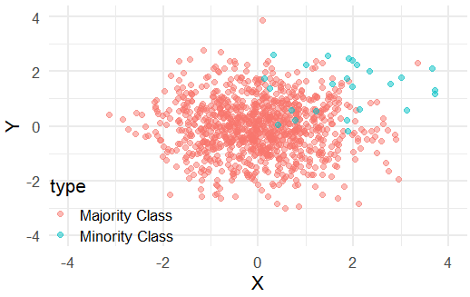
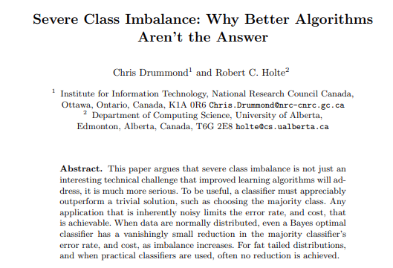
What Is Class Imbalance?
Class Imbalance occurs with classification models where one class severely outnumbers the other class(es)
What is significant imbalance? Anything less than ~10-5%
This creates problems for any classification algorithm. Even AI isn’t immune!

Slide 33
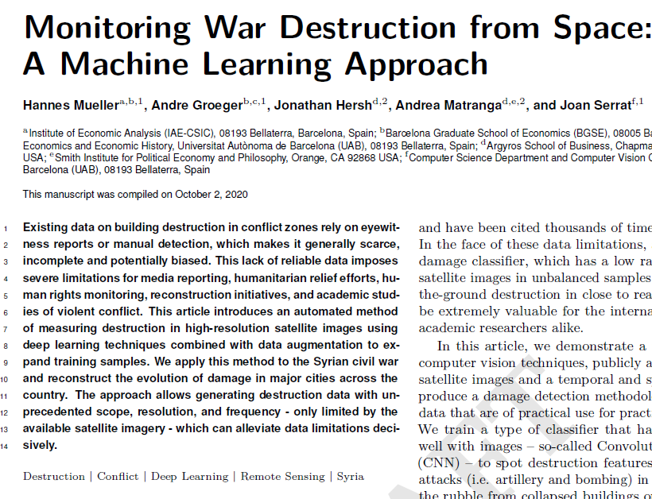
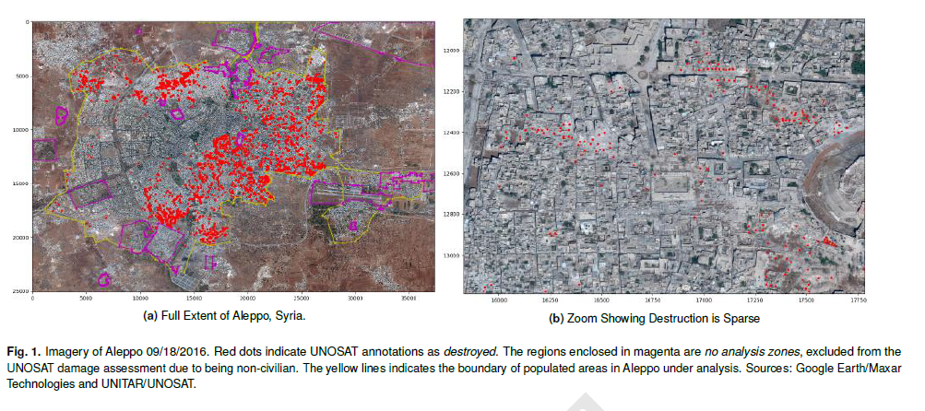
My own work: finding which buildings have been bombed using machine learning applied to satellite imagery is hard because most buildings are not bombed, even in Syria!

Slide 34
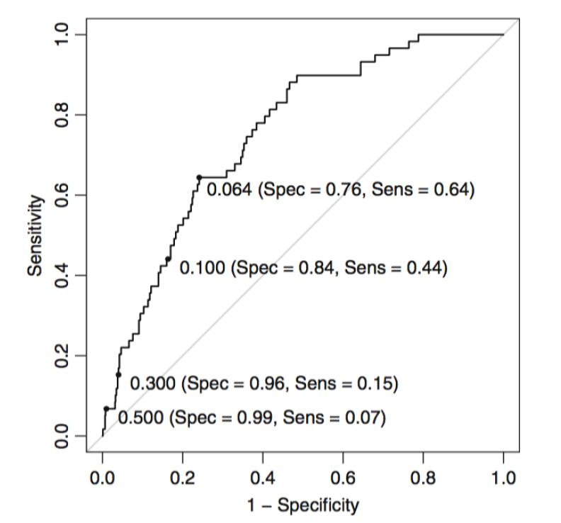
Remedy 1: Alternative Class Threshold
First solution may be to choose a different probability threshold
Each threshold from the ROC plot shows a different resulting specificity or sensitivity
For applications we care more about sensitivity (low FNs), for others we care are specificity (low FPs)

Slide 35
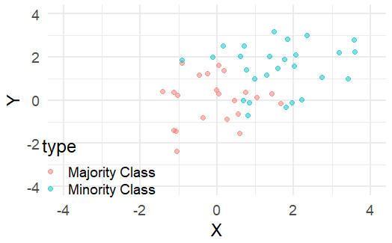
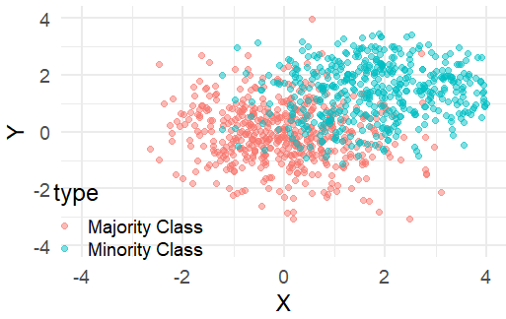
Other Remedies: Up-Sampling and Down-Sampling
Down-Sampling creates an artificial data set with equal minority and majority cases
Up-Sampling creates an artificial data set with more (repeated copies of) the minority class
Down-Sampling
Up-Sampling

